Slide 1

Section H: OTHER DISORDERS
Chapter H.6
PROBLEMATIC INTERNET
USE (PIU)
Jane Pei-Chen Chang & Chung-Chieh Hung
Companion PowerPoint Presentation
Adapted by Jane Pei-Chen Chang

Slide 2
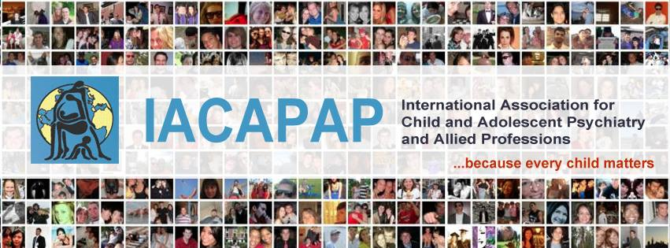
The “IACAPAP Textbook of Child and Adolescent Mental Health” is available at the IACAPAP website http://iacapap.org/iacapap-textbook-of-child-and-adolescent-mental-health
Please note that this book and its companion powerpoint are:
· Free and no registration is required to read or download it
· This is an open-access publication under the Creative Commons Attribution Non- commercial License. According to this, use, distribution and reproduction in any medium are allowed without prior permission provided the original work is properly cited and the use is non-commercial.

Slide 3

Problematic Internet Use
Learning objectives:
Definition/Diagnosis
Epidemiology
Pathophsyiology
Treatment
Course and Outcome
Prevention
Notes:
By the end of this presentation, you should understand the following about problematic internet use in children and adolescence.

Slide 4

Problematic Internet Use
The Basics
Definition
  Behavior/ Illness
Diagnosis
https://www.youtube.com/watch?v=pB5cSLdOr8U&feature=related
World of Warcraft
Dangerous addiction or cultural phenomenon?
Notes:
So is PIU a behavioral problem or an illness?
PIU merits our attention since children and adolescents are more likely to indulge most of their time in Internet games, activities, and social networking at the expense of their school work and sport.
PIU can arise from involvement in a range of online activities.
Block has proposed to include internet addiction disorder in the DSM-5.
South Korea has also declared internet addiction as a serious problem and public health hazard.
Click on hyperlink to see documentary.

Slide 5
Problematic Internet Use
Definition
Maladaptive preoccupation with internet use, experienced as irresistible, for periods of time longer than intended
Significant distress or impairment resulting from internet use
Absence of other psychiatric pathology that might explain the excessive Internet use.

Slide 6
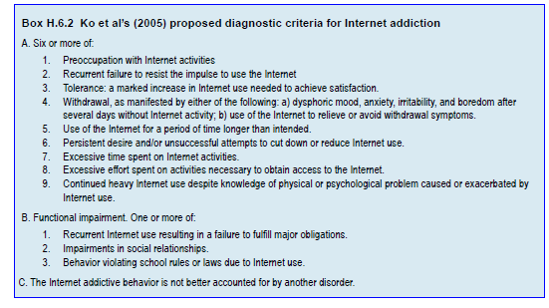
Problematic Internet Use
Diagnosis
Notes:
This is the proposed diagnostic criteria for Internet Addiction by Ko et al.
A few components should be take into evaluation to determine the problematic nature of internet use
Such as
Salience: prominent use of the Internet
Mood modification: moody when not being able to use the Internet
Tolerance: need to spend more time on the Internet
Withdrawal: feeling agitated and irritable when the Internet is inaccessible
Conflict: conflict with family and friends when not able to access the internet
Relapse: fails to stay away from using the Internet after a period of abstinence from Internet use.

Slide 7
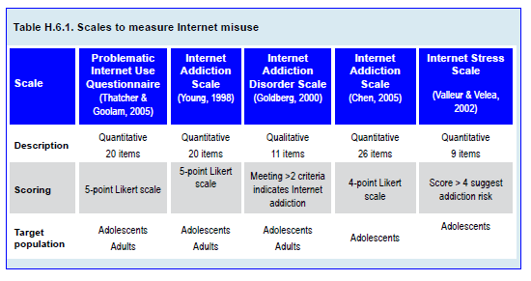
Problematic Internet Use
Measures

Slide 8
Problematic Internet Use
Epidemiology
Prevalence rate: 1%-18% of adolescents
  Western societies: 2-12%
  Eastern societies: 2-18%
Gender
  Boys tend to have higher rate for PIU
Notes:
The Internet has become the most popular medium utilized by the general population, especially by children and adolescents. It is as common for children to use a computer as it is to play with their favorite toys. Studies have shown that the percentage of students using the Internet has increased dramatically, for example from 24.5% to 79.5% between 1996 and 2001 in the US (Odell et al, 2000). The number of Internet users who go online regularly had surpassed 1.5 billion in 2009 ─19% of them in China alone (Flisher, 2010).
No reliable data exist on the global prevalence of this phenomenon. Estimates vary from country to country and from study to study. It has been estimated that 1%-18% of adolescents have PIU in both Western and Eastern societies (Cao et al, 2007; Jang et al, 2008). More specifically, about 1%-2% of Italian students have moderate to severe PIU (Poli & Agrimi, in press), 1%-12% of children and adolescents in Middle Eastern countries (Canan et al, 2010) and 2%-18% of children and adolescents in Asian countries appear to have PIU (Cao & Su, 2007). Small scale studies in Korea and China revealed that around 2% (210,000) of South Korean children aged 6 to19 years have PIU and many may require treatment (Choi, 2007), while around 10 million adolescent Internet users in China may meet criteria for Internet addiction (Cao & Su, 2007).

Slide 9
Problematic Internet Use
Negative Consequences
Impaired academic performance
Impaired social interaction/family relations
Decreased self-perceived acceptance by peers
Increased drinking in males
Lower self-worth in females
Notes:
The negative impact of Internet usage on individuals and their lives is often underestimated. Brown (2006) suggested that the choice of media individuals make is influenced by their character and the way they interact with the world; in turn, the way individuals interact with the media will be incorporated into their daily life, influence their behavior and views and even the development of their brain. Children and adolescents are more susceptible to trade off their real life activities with virtual reality ones. Young people are also more prone to use the Internet as a form of socialization without realizing the negative impact that may carry. Thus, when Internet use starts to take up a large portion of children’s and adolescents’ time, affect their mood, and jeopardize academic and social function and performance, Internet usage may become a problem that may require intervention.

Slide 10
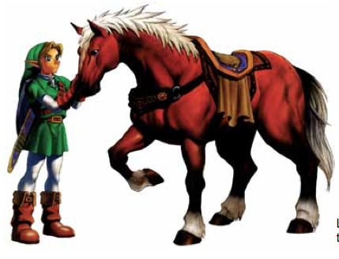
Problematic Internet Use
Associated Psychiatric Symptoms and Comorbidity
Hostility
Depression, irritability or mood changes
Phobic anxiety
Daytime sleepiness or sleep deprivation
Legend of Zelda: Ocarina of Time, one of the most popular video games

Slide 11
Problematic Internet Use
Negative Consequences
Studies with adults show association with:
Social isolation
Academic failure
Financial problems
Job loss
Marital discord
Aggression
Failed marriages
Unemployment
Neglected children
Sleep deprivation
Losing control
Craving and withdrawal
Notes:
Excessive Internet use in adults has been associated with failed marriages, unemployment, neglected children, and sleep deprivation (Young, 1998). Young’s research on problematic internet usage (PIU) has documented associated symptoms and problems, including losing control, craving and withdrawal, social isolation, academic failure, financial problems, job loss, and marital discord. Moreover, spending more than 18 hours a day online may lead to physical problems such as back pain, eye strain and carpal tunnel syndrome (Young, 1998). Internet addiction is considered a public health issue in South Korea (Block, 2008), where 10 cardiopulmonary-related deaths in Internet cafes (Choi, 2007) and a game- related murder (Koh, 2007) have been reported. In addition, Internet videogames are now more sophisticated, more violent, and often incorporate multiple players when compared to online games two decades ago (Anand, 2007). A negative correlation has been reported between time spent playing Internet games and academic performance, and a positive association between violent Internet game- playing and aggression (Anderson & Dill, 2000). Not only does excessive Internet use has a negative impact on the mental and physical health of children and adolescents with PIU, it might also increase risk of violence in this age group.

Slide 12
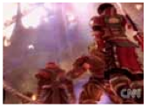
Problematic Internet Use
Possible Negative Effects
https://www.youtube.com/watch?v=NdDmp_Ak1no&feature=related
Notes:
Internet gaming addiction leads to baby’s death. Click on the hyperlink to watch video.

Slide 13
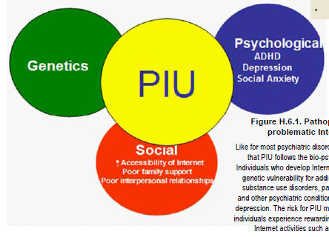
Problematic Internet Use
Pathophysiology
Notes:
Interaction between bio-psycho-social factors
Onset of PIU is most likely during late childhood and early adolescence (Pridgen, 2010).
Adolescence is a period of biological, psychological and social changes and navigating these changes is stressful for many youths.
Adolescents with emotional and behavioral disorders are also more vulnerable to the negative effects of Internet Use (Pridgen, 2010).
Affected youth often deny their problems with Internet use, denial being one of the main factors in maintaining PIU.
Like for most psychiatric disorders, it is hypothesized that PIU follows the bio-psycho-social model. Individuals who develop Internet addiction may have genetic vulnerability for addictive disorders (e.g., substance use disorders, pathological gambling) and other psychiatric conditions such as ADHD and depression. The risk for PIU may also increase when individuals experience rewarding experiences through Internet activities such as online gaming.

Slide 14
Problematic Internet Use
Risk Factors
Psychiatric Comorbidity
  Attention deficit hyperactivity disorder
  Depression
Social support
  Socially isolated
Low self esteem
Poor quality family relationships
Loneliness

Slide 15


Problematic Internet Use
Effect on the Brain
fMRI similar to substance addiction
Changes in orbitofrontal cortex and anterior cingulate cortex
Poorer executive control and impulse control
https://www.youtube.com/watch?v=VwNY_-FiwYU
https://www.youtube.com/watch?v=26KPzJwt6wQ&list=PL5F250D3E5D945F37&index=1
Notes:
Researches have shown that some of the behavioral and neural characteristics of individuals with PIU are similar to those of individuals diagnosed with pathological gambling and substance use disorders (Ko et al, 2009). This is further supported by a recent functional magnetic resonance imaging study where a cue- induced online gaming urge activated similar brain areas as those activated by craving for drugs in people with substance addiction (Ko et al, 2009). Increased activation in the orbitofrontal cortex in gain trials and decreased activation in the anterior cingulate cortex in loss trials have been described in individuals affected with PIU (Dong et al, in press). Individuals with PIU also exhibit poorer executive control and poorer impulse control than non-affected individuals; for example affected individuals had longer reaction times and more response errors than their counterparts in the Stroop Test (Dong et al, 2011).
Click on the hyperlink on the left to see Dr Paul Howard Jones assess whether the latest scientific findings support popular fears about what technology is doing to us.
Click on the hyperlink on the right to watch an interview with David Greenfield PhD on Internet and video game addiction

Slide 16
Problematic Internet Use
Treatment
Currently no treatments supported by evidence
  Not an official diagnosis
No pharmacologic nor psychotherapeutic intervention has received adequate testing
Shortcomings of current treatment studies of PIU.
Notes:
There are currently no treatments for PIU that are supported by evidence, which is not surprising considering that it is not yet an officially accepted diagnosis. No pharmacologic or psychotherapeutic intervention has received adequate testing in randomized controlled trials. Most interventions suggested for PIU are based on personal clinical experience, small anecdotal studies or trials without randomized double blind design. A recent systematic review showed several limitations in available clinical trials (King et al, 2011). These include:
Inconsistencies in definition and diagnosis
Lack of randomization and blinding
Lack of adequate control groups, and
Insufficient information concerning recruitment, sample characteristics, and treatment effect size.
These shortcomings are highlighted in Table H.6.2, which summarizes the characteristics of Internet addiction treatment studies currently available.
While there is no agreement on the diagnostic criteria for Internet addiction or PIU, there seems to be a demand for treatment for these problems, especially in China, Taiwan, and South Korea (King et al, 2011). Interventions for PIU range widely from boot-camp style programs in Eastern countries to clinics specializing in the psychological treatments including CBT, family and group therapy, social skills training, and addiction counseling (King et al, 2011). Programs often extrapolate treatments used for substance abuse.
Before going into details about intervention, a careful clinical evaluation and assessment of comorbid conditions is essential. For example, a depressed child may start leading a virtual life to boost his self-esteem at the expense of offline interactions and duties, hence treating the depression will be a priority in this child’s treatment plan.

Slide 17
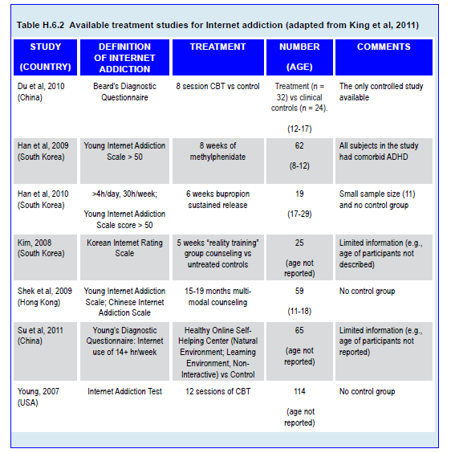
Problematic Internet Use
Treatment

Slide 18

Problematic Internet Use
Treatment
Family based intervention may work
Tailored management
https://www.youtube.com/watch?v=VtMJ4NJvTwI
Notes:
Click on the hyperlink to watch a news item about Internet addiction in China
There has been no double-blind placebo-controlled study on the pharmacotherapy for PIU. Thus no specific medication can be recommended at this stage, although a wide range of them has already been tried, as summarized in Table H.6.2. The only randomized controlled study published so far allocated 56 adolescents aged 12 to 17 years into either active treatment (8-sessions of multimodal school-based group CBT) or no treatment (Du et al, 2010). While Internet use decreased in both groups, the active treatment group improved more in the areas of time management, emotional, cognitive, and behavior symptoms.
Children and adolescents affected with PIU may benefit from family based interventions, although there is no evidence so far that this is the case (Yen et al, 2007). For example, family therapy may help to improve communication within the family and teach Internet techniques to monitor Internet use better (Yen et al, 2007). Ironically, PIU may also improve with online educational programs (King et al, 2011). There are several online services, mostly based on the ‘12 step’ self- help treatment philosophy.

Slide 19
Problematic Internet Use
Treatment: Behavioral Strategies for Clinicians and Self-Help Tips for Patients
Identify pattern of use with logbook
Set clear, specific goals
Limit and shorten Internet usage time
Negotiate one computer free day per week
Use reminder cards of negative consequences of Internet use
Make a list of former hobbies or interests
Increase time spent on sports, hobbies and other non- Internet activities
Join PIU support group
Notes:
Help patients identify their pattern of Internet use using a logbook.
Set clear, specific goals with the
patients.
Limit and shorten Internet usage time. External prompts, such as timers may be helpful to remind them when it is time to log off.
Negotiate a computer free day once each week.
Write down negative consequences of
Internet use on reminder cards and encourage patients to carry and read them.
Help patients make a list of hobbies or interests they used to enjoy.
Increase time spend on sports, hobbies and other non- Internet activities
Join a PIU support group.

Slide 20
Problematic Internet Use
Course and Outcome
High relapse rate
  Ready accessibility of Internet
  Low awareness

Slide 21
Problematic Internet Use
Prevention
Increase awareness of PIU
Parental supervision for internet use
Set time limits tointernet use for children and adolescence under age of 18.
Notes:
It is very important for the public to know that PIU is a serious problem and is a public health Hazard.
Education should be provided to parents about parental supervision including time limits on internet use.

Slide 22
Problematic Internet Use
Further Information
Websites offer help for problematic internet use
www.netaddiction.com
http://www.netaddictionrecovery.com

Slide 23

Problematic Internet Use
Thank You!

